Slide 1
Modeling the cognitive process during experimental games using hidden Markov models
Xiaomin Li and Colin Camerer
Speaker: Xiaomin Li, Oct 2021
Notes:
Thanks for inviting me to this wonderful workshop, today I will introduce the use of hidden markov models on choice process data particularly in strategic game task. I will show how HMM naturally fits the strategic struture by providing examples of new explainations and new predictions, we are curious about like levels of the reasoning.
11s

Slide 2
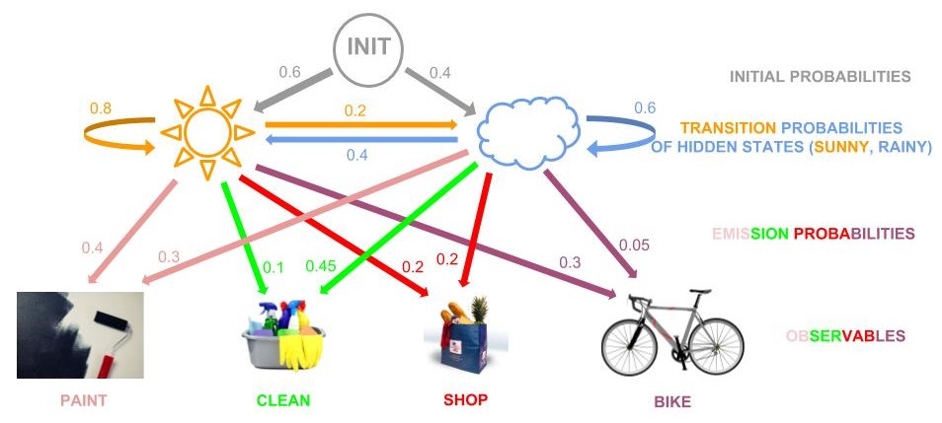
Hidden Markov Model
Why HMM?
Advantages:
Explainable
Reliable
HMM is a machine learning model for problems where the goal is to recover a data sequence that is not immediately observable
Happy
Sad
Data:
Bike-paint-paint-shop-clean
Notes:
Before I say anything else, let’s just together have a one slide crash course on what a general hidden markov model is. I believe many of you will get the point immediately after the tutorial.
Hidden markov model is well-established machine learning literature that are proved to be useful in many applications like speech recognition, sequence data generation and recommandation systems. I need to tell you that it is not that HMM is not the top-notched state transition model. The popular ones nowadays are neural net based like rnn, transformer, or attention models. But HMM has two huge advantages: 1) is reliability that it has been proven to work on many applications already. 2) explainable, most deep learning models are hard to explain. And plus, the scope of the today’s talk is on experimental choice process data, so HMM is more than enough for our scenario.
How does this model work exactly? Imagine we observe sequences of activities like paint, clean, shop, shop....and etc generated by someone on daily basis. We think further that there is some kind of underlying mechanism that drives your behavior but we cannot observe. One example can be the moode of this person on that day. So on the first day, nature randomizes a mood for this person and his mood changes over time according to some markov chain. Conditional on what mood he has on a certain day, this person will have different sets of probabilities choosing his activivity. For example.The HMM model tries to learn this logic from the data and outputs two things: a Markov chain between a prespecified number of hidden states and a map from hidden states to the observable outcomes.
5min

Slide 3
Background
Crawford, Costa-gomes and Broseta (2001), mouse-tracking and information search.
Wang, Spezio and Camerer (2010) , Polonio Guida and Coricelli (2015), Polonio, Devetag and Guida (2016), Zonca, Coricelli and Polonio (2019), eye-tracking on different non-cooperative games, pre-specified patterns, many talks today!
Krajbich, Armel and Rangel (2010), Krajbich and Rangel (2011), , Golman, Bhatia and Kane (2019) : Sequential sampling method to model gaze (DDM)
Notes:
There is a growing number of literature as we can see even in this conference that study games using process data.
Here I just listed some early ones and published ones.
Most of them use matrix games. And the common way to do it is to test a whether a particular transitional patterns exists and how does that tell us something about strategic types.
In cogntivie science, people have a longer tradition study eye tracking and decision making. A well-established model to use is the sequential sampling types of model like aDDM. It has not been widely applied to strategic games yet.
1min

Slide 4
Motivations of HMM
How to model the dynamic strategic reasoning using choice process data: eye-tracking and mouse tracking?
Generalizable: Easy to apply to any games
Explainable: New insights about the cognitive process
Notes:
Given the background, here comes the motivation of why we need HMM.
And there are two points that this model can bring us
50s

Slide 5
Hidden Markov Model in Strategic Games
P:
Transition Probabilities in hidden states
B: Mapping: hidden states to observations
Pi: Prior distribution
Notes:
Now, let's see how this model can be used in games. Just like the weather activity example, in games there are also two parts: the unobserved hidden states and the observables: gazes and choices. Where exactly are gaze data? they are actually location coordinations on the space of environment stimulus.
Now let's imagine a person enters a game. First he initalize a distribution over the hidden states. That's his initial thoughts. Then he can either think further, means he keep trasitting in the hidden markov structures. We can think of the hidden states as mental activities under his mind. And during thinking, it is inevitable that he will leave evidence, that evidence is the gazes. HMM is trying to learn the connection between real world and his mind. 1m18s

Slide 6
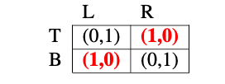
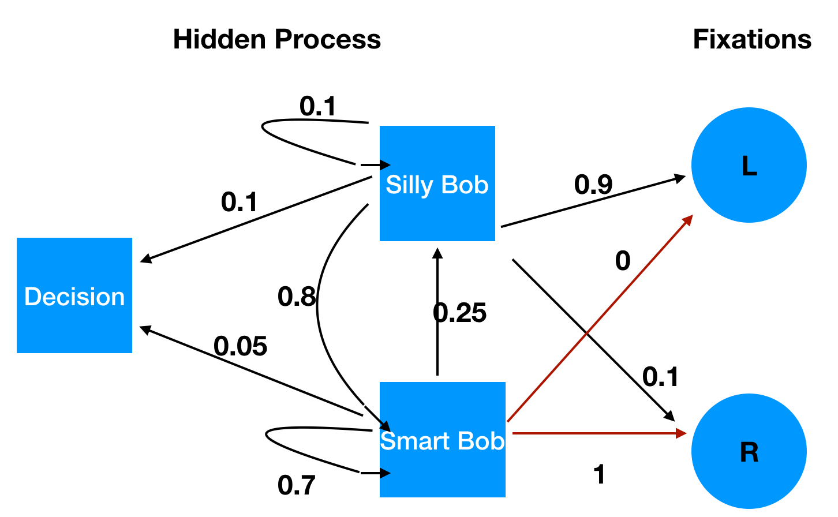
A Naïve example
Begin
Ann
Unobserved, Typical Markov Chain
Emissions
Bob
Notes:
Now let’s see how the model works in games. A matching penny example that we are all familiar should help. We will try to walk the process forward instead of the inference direction.
This example is on the perspective of ANN, After the game starts, Ann needs to form a belief about Bob’s strategy dynamically, it could be the trivil strategy that whether Bob is choosing top or or bottom. Ann first think, Bob will chose Top, L, bottom, so on so forth.
This dynamic transition process of beliefs is exactly the levels of reasoning we talked over and over again in the literature, but over so many years, it is always just a hypothesis. Just like we could never read somebody’s mind. But fixation transitions give us hope. Fixations can be understood as probalistic projections of the mental states at each time.
We we want to do is trying to back out both the hidden state partition and the transition matrixs using the data we have.
1min 26s

Slide 7
Application 1: Normal Form Games Data from: Zonca, Joshua, Giorgio Coricelli, and Luca Polonio. "Gaze patterns disclose the link between cognitive reflection and sophistication in strategic interaction." (2020): 230-245.
Notes:
We will show two different applications of how to this model. The first one is our familiarized matrix game.

Slide 8
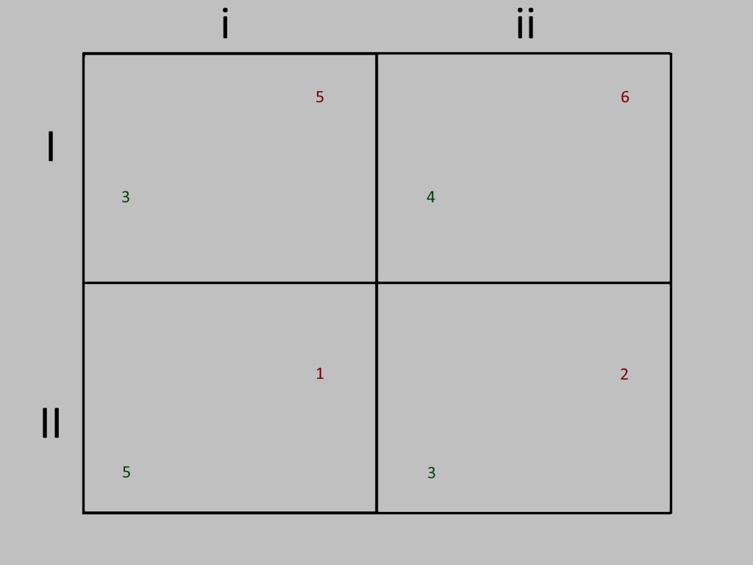
Dataset – Zonca, Coricelli and Polonio (2019)
48 games, 16 DSS, 16 DSO, 16 multiple equilibria
N=100
Only row players
Fixations: eight AOIs (payoffs)
Notes:
Thanks to Zonca, corricelli and polonio for sharing their data with us. We first apply the model on an eye tracking datasets collected during subjects playing various matrix games. The visual display of a matrix game will be like this and there are 8 areas of interest corresponding to 8 payoff numbers. 48 different games were used in total that have different payoff numbers and spans over three categories, dominance self solvable, dominance other solvable and stag hunt which contains two eq. 100 participants participated in this experiment. They are all row players that they choose between rows than columns.
43s

Slide 9
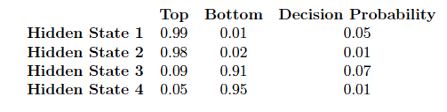
HMM in normal-form games
Strong saliency effect
Information structure
Action x Role
No diagonal transfer
“Hypothetical play”
Notes:
We fit the data in all games across all players using HMM trying to summarize a generalize a pattern. Here is what we found. The model learned that each hidden state correspond to a row of payoffs in the matrix. With the initial distribution heavily biased in hidden state 1. This suggest that most people start thinking by this row of payoffs.
Another interesting finding here is that subjects rarely transit diagonally in this graph, so I didn’t label those arrows in the graph. They only do it in a circle. For example, from state 1 to state 3, you are comparing your own payoffs by simulating your two possible moves. And if one is transiting horizontally, that means he is switching roles from looking at his own payoff to the opponent’s.
%We prespecify four hidden states in the reported model. We have also tried other number of hidden states and found these four states existing there as well.
1m 30ss

Slide 10
Locations games Data from: Li, Xiaomin, and Colin Camerer. "Predictable Effects of Bottom-up Visual Salience in Experimental Decisions and Games.” forthcoming, Quarterly Journal of Economics, 2021
Notes:
Next, I will demonstrate the use of this model in a task summarized in previous paper of ours.

Slide 11


Matched!
Coordination
Hiding
Seeking
72 Images
animation
N=29
Within Design
Notes:
subjects need to play three games, coordination, hiding and seeking games in three randomized blocks. In each block, there will be dozens of different images. Subjects are presented with a colored image like this one. He needs to choose by mouse clicks.

Slide 12

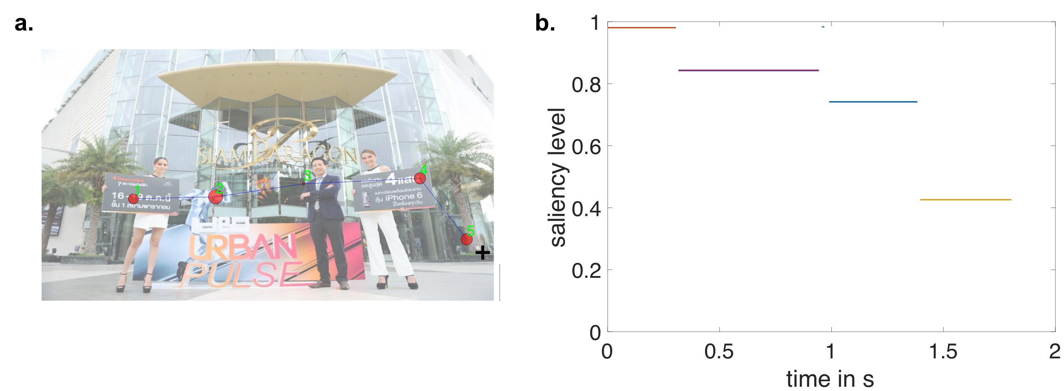
Fixation Data and the saliency metric. (Camerer and Li 2021)
Saliency:
Measures the level of attentiveness
Map all locations to a saliency value from 0 to 1
Notes:
Based on our previous finding and evidence from other papers, we found that instead of choosing the 2d coordinates, the real action space subjects are using is the one dimensional saliency map.
And This is a sample of what eye tracking data looks like in location games.
It consists of fixation and saccades.
Fixations Definiation, when you look at a location for long enough.
Saccadeds are simply transition trajectory between fixations.
Based on a previous finding in Li Camerer 2020, we found that people are actually play using a saliency map that assigns a value called saliency from 0 to 1 to any point in an image. Intuitively, the saliency metric measures how prominent a spot will stand out from its surroundings.
Therefore, each fixation location in the 2D image space is now reduced to be one dimensional saliency value.

Slide 13
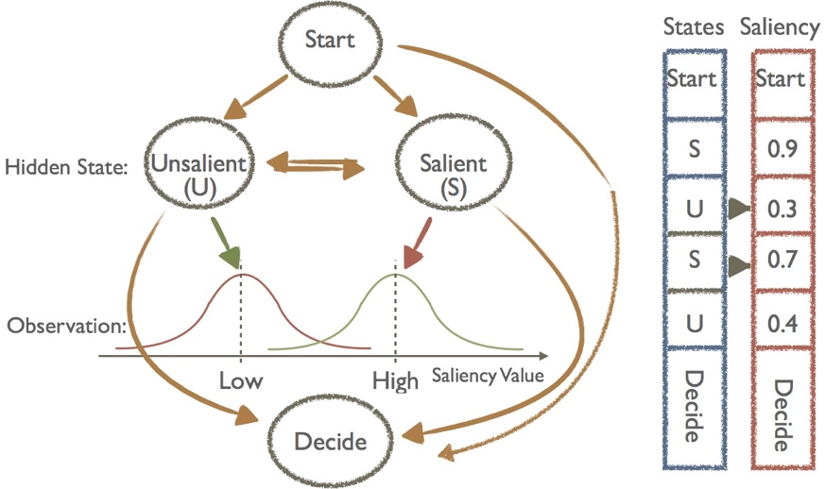
Gaussian hidden markov model (gHMM)
Transition Matrix
Observational Map
Notes:
Now we are going to specify an HMM model in this game.
We pre-specify two hidden units representing subjects' mental states. And remember our observations are different saliency values like .9, .3, .7.....
And since our observational space is continuous now, As a tradition, we assume mixed gaussian distributions from hidden state to the saliency space. Since
Data 1min 30s

Slide 14
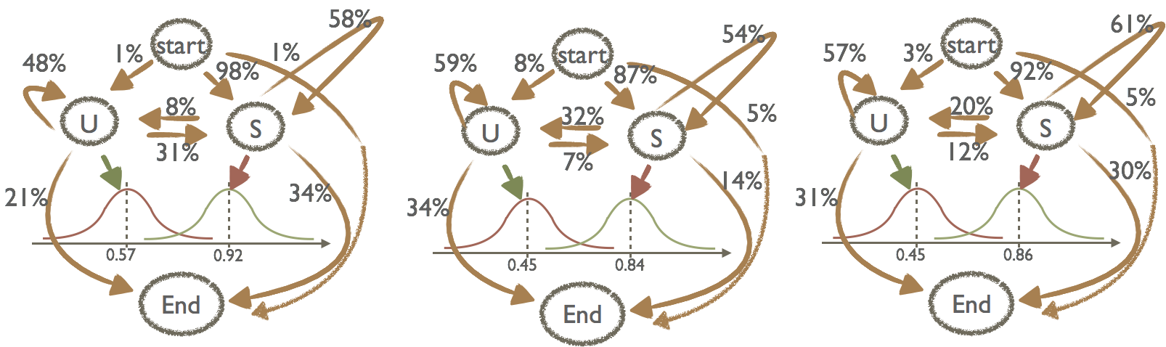
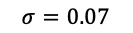
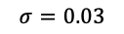
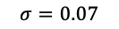
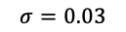
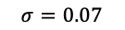
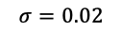
Fitted Model
$$σ=0.07$$
$$σ=0.02$$
$$σ=0.07$$
$$σ=0.03$$
$$σ=0.07$$
$$σ=0.03$$
saliency
saliency
saliency
Matching
Hiding
Seeking
Estimate the model using a standard Baum–Welch algorithm
Notes:
We fit three different models using the standard BW algorithm, for three strategic cases.
1. hidden states separations are similar across games. With the high saliency state to be super salient and the low state to be medium salient.
2.
We can see that the First fixation can be reliably predicted by the bottom up process and is common regardless of tasks.
On later fixations, the strategic part kicks in and people start to sample the unsalient locations more.
30s

Slide 15
Gaze predicted strategic levels
Levels are defined as transitions among hidden states along the direction of the best response function.
Example: { S, U , S}, level 2, { S, U}, level 1, { S}, level 0
Notes:
Given the estimated model, The hidden markov approach naturally induce a system of strategic levels.
Unlike the traditional methods, we don’t need an assumption of a level zero behavior, whatever learned in the first step will be our natural level zero behav.
The decision maker will move to the next level as long as he transit to a different state on the direction of the best response function. It's also simple to understand, for hider seeker games, when he is on salient state, he should imagine the next level to be on unsalient state.
This figure shows the estimated levels of reasoning for the dataset we have. Recall that this result is purely estimated from gaze data only.
The distribution of levels fits well with poisson distribution which was assumed in previous literature. And the estimated mean level is around 1 for hider-seeker game, 1/2 for matching game. indicating that most people don't go very far in this process.
2min

Slide 16
Gaze-predicted strategic levels
Advantages:
It is directly defined on mental states transitions
No assumption for level zero behaviors
Defined on a trial basis instead of individual basis
Connects well to the traditional definition for validations
Notes:
Comparing to the traditional behavioral approach, this new model has its unique advantages.
The comparison of the estimated level using three methods are shown here.
1min30s

Slide 17
Individual strategic levels across games

Slide 18
Continuous-time gaussian hidden markov model (ctHMM)
Discrete Emission: U -- S – U – S – End
Continuous Emission: U -.2s- S -.1s- U -.4s- S -.7- End
Include fixation duration time to the HMM model
Now, the observation matrix are known!
Need to modify: the hidden transition matrix changes from P to P(t).
P_{ij}(t): at each time point, condition on that I am at i state, the probability I will transit to j state.
Notes:
Later, we further extended the model to incorporate the fixation duration along with the fixation location.
The model now becomes a continuous-time Gaussian hidden markov model. In the discrete case, our goal is to predict a sequence of hidden states without time. For continuous version, we just want a prediction to look like the purple sequence, with time in between states!
The good news is that we don’t need to re-estimate everything from scratch! We already have the observation map from hidden state to fixation space already. This way, we only needs to estimate P_ij(t).
1min 14s

Slide 19
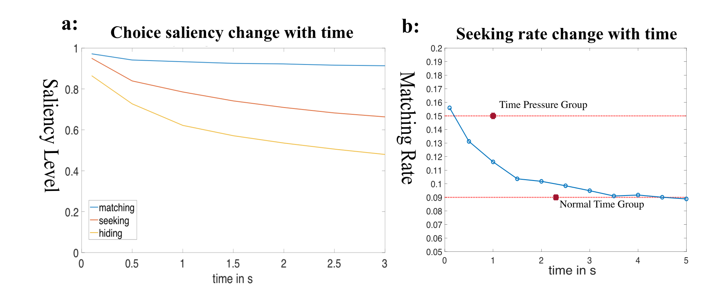
Use cgtHMM to predict time pressure effect
State transitions: U, S , U, S, S, U, End
Time in s: 0.3, 0.4, 0.5,0.3,0.2,0.4, End
Hard Stop
Natural Stop
Force a Choice
Notes:
With the estimated model, A use of the cgtHMM is trying to predict choices under time pressure. To do that, we boldly assume that the last state a subject is considering will be his decision schema when we set a hard stop on the markov chain.
A hard stop means that we truncate the chain manually in the middle at a given time. This way, subjects are forced to make a choice without full consideration.
Now, we will let this trained model play the hider-seeker game and see whether they will show seeker advantage and how does this rate change when they face a time pressure.
We first simulated the probability of being at each state as times goes by, this is shown in figure one. We can easily get the fixation saliency value according to the observational map. Then, we need to back out choice on the 2D image from saliency value. We go back to the image pool and choose the corresponding pixel according to the saliency value. With large enough images, we got the seeking rate changed over time shown in figure b. The two red bars are the data level for both the normal group seeking rate and the time limit group seeking rate.
We can see that this model converges to .09. And it’s the magic seeking rate we found over and over and couldn’t get it to any lower.
This result, estimating purely from eye tracking data and saliency space confirms that bottom saliency is the main driving force for our finding. With a HMM model, we can see clearly that bottom up process only affects the first fixation and the decision function causes the later influence. That's why this effect was not that strong comparing to the first fixation but super robust.

Slide 20
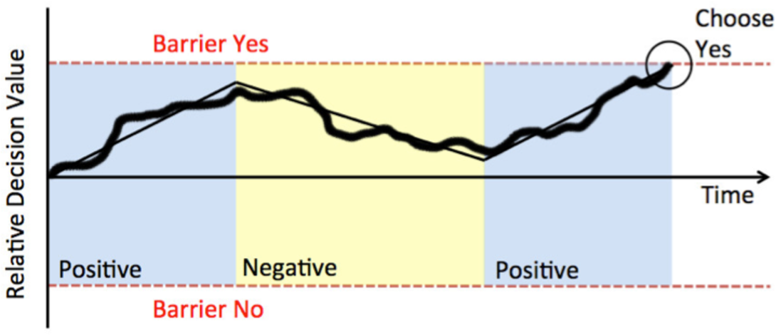
Why we need HMM?
DDM restricts the fixation data only on choices themselves, it cannot incorporate other information like counterpart payoff.
DDM limits in the number of choices, it works best for a two choices problem.

Slide 21
Conclusion
Proposed a new method, HMM, to dynamically model eye-tracking data.
1. Easy to generalize and estimate. 2. Noise resistant and learns principle components.
Application:
In location games, continuous action space, information space: non-neutral frame/images without payoff.
Still see a transitional effect and strong saliency effect.
HMM induces a new system of levels that have many advantages.
HMM can further incorporate duration time and make predictions about time effect.

Slide 22
Thank you!!

